Slide 1
Empowering business and delighting customers with Salesforce
September 2016

Slide 2

OUR DIFFERENTIATOR: Our Pace and unique ‘iterative’ Scrum Method of delivery for projects to retain business relevance and enable higher adoption by users.
COMPANY OVERVIEW
OUR VISION is to be
a company of EXTRAORDINARY professionals
that delivers business solutions LEVERAGING SALESFORCE TECHNOLOGY
by being the PARTNER OF CHOICE to our clients,
and in doing so, EXCEED expectations.
OUR STRENGTH:
Our Predictability which is similar to that of a big company, and our Agility and Passion akin to a boutique company equips us to deliver the best possible outcome for any Salesforce implementation.
2016 GOAL:
To be the Go-To-Partner for Salesforce solutions in India and U.S. We are positioned as a “Problem-Solving Company armed with the World’s Best Customer Success Platform.”

Slide 3




“We decided to acquire a strategic equity stake in ET as its aligned very well with our digital growth strategy. We also have great confidence in ET’s proven executive team that was part of a hugely successful enterprise software services business prior to ET. We were impressed by the leadership, culture and passion of George and his team. Our common goal is to build applications on top of the Salesforce platform in industries that are ripe for digital disruption.”
– Siby Vadakekkra, Co-Founder and CEO, Marlabs
ET Marlabs is the Salesforce Practice of Marlabs Inc.
Marlabs drives digital agility for clients and delivers innovative business solutions using digital technologies such as Cloud, Mobile, Analytics, Internet of Things and Social.
The company has a strong team of over 2,100 associates, a network of delivery centers in USA, Canada, Mexico and India, and strong partnerships with industry leaders.
It offers a wide range of IT services across industries with an emphasis on quality driven by CMMi, PCMM, ISO 9001-2000, ISO 27001, and SSAE 16 Type II best practices, and a customer-centric client engagement model.

Slide 4

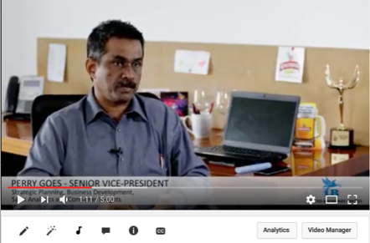

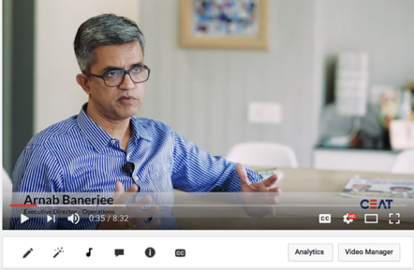


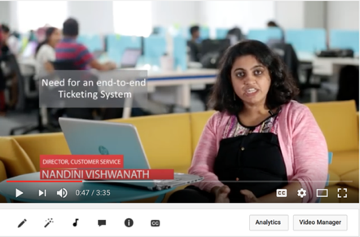

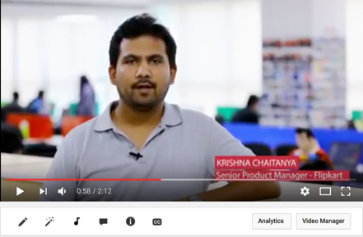
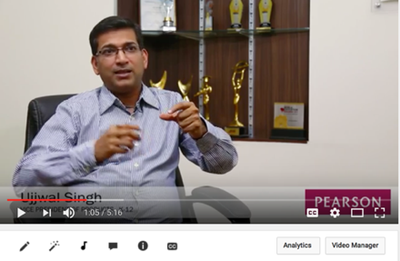
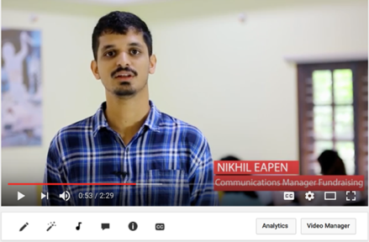


Brand Promise: Client Bliss
We won the “Best Salesforce Implementation Partner FY15” Award from Salesforce in India.
The award is a reinforcement of our hard work, conviction and contribution to the CRM and Technology industry over the past five years.
ET Marlabs is a 100% Salesforce-focused company and a Salesforce Gold Cloud Alliance Partner. Started in 2011 by experienced IT/ITES professionals, the company has worked with some of the best logos in the business. At ET, a project is complete only when the customer is smiling.

Slide 5
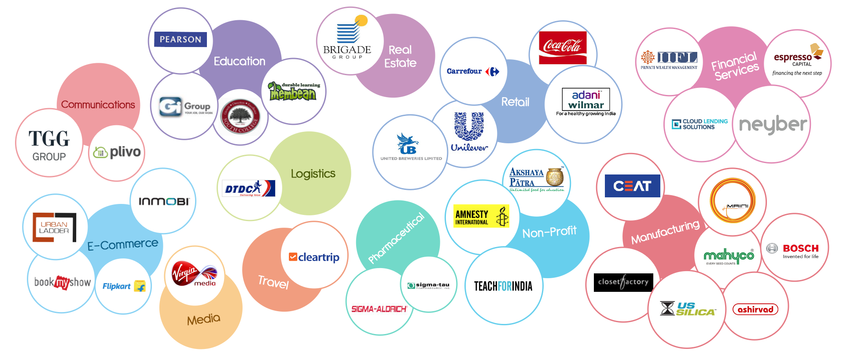
Brands & Clients

Slide 6




Capabilities
Leadership team with over 200+ years of combined IT/ITES experience.
Client roster includes some of the biggest brands from India, US, Australia and UK.
In-depth and end-to-end Salesforce Consulting & Implementation skills.
15
100
380+
100+
96%
US $
1.6 MN
100%
INDUSTRY VERTICALS
CUSTOMERS
PROJECTS
EMPLOYEES
EMPLOYEE
RETENTION
REVENUE
2015-2016
CERTIFIED
Deep platform knowledge and cross-industry experience.
Ability to understand unique business requirements requiring scalable/extensive user adoption.
Experience in the implementation of complex projects with a high degree of flexibility and perfection.
User-centric approach to understanding business and designing solutions.
On-site expertise in deployment, integration, training, support, adoption and QA audits.
In-house Technical Council comprising of Technical Architects and Software Engineers to provide advice and guidance throughout the project.

Slide 7


Certifications
26
1
33
3
17
11
7
15
5
1

Slide 8











Offerings
Custom App Development
UX/UI Design
Call Center Integration
Service Process Automation
Sales Process Automation
Scoping and Solution
Integration Services
Implementation Effectiveness
Review
Testing Services
Administrative Services
& Enhancements
Accelerators/Go-to-Market Templates
for (select) Industries

Slide 9
Sandd for business
Sales & Distribution Product

Slide 10


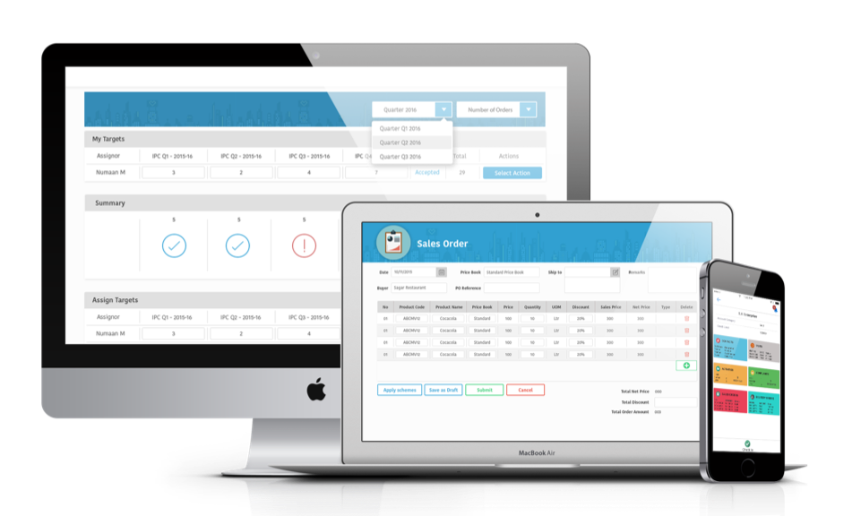





IP/Product
Scope to customize
and scale
Secure online
cloud-based app
Pay-by-use
Less capital investment,
low risk
Minimum time to procure
and deploy
It can be used by any industry, for any size of business operations. The product is available on the Salesforce App Exchange.
SandD is a mobile-focused, flexible and versatile cloud-based Sales & Distribution product built on Force.com platform and Salesforce1 to add mobility to your sales and help boost revenues.
The app, which literally sits on top of the user’s existing Salesforce platform, is comprehensive, customizable and scalable.

Slide 11





IP/Product
FEATURES
SandD has three main parts that enable the Field force - starting from the top level Head or Manager to the grass root level Executive or Field Force: Planning, Execution, Order-taking & Fulfilment.
Goals and Targets
Uncover unlimited possibilities in sales
Real Time Location Tracking with Dynamic Maps
Reach your destination faster
Our app can be used by a variety of industries
Permanent Journey Plan
Plan your visit in advance
Single Screen Dashboard View
Day at a glance
Reports and Dashboards
Have a grip on everything
Planned Vs Actual
Take stock after each visit
Financial Products
Telecom
Airlines
Data to Enrich Interaction Experience
Manage distributor accounts better
Customized field campaigns
Maximize on marketing schemes
Order Management
Wrap up business before going home
Simplified Integration with Third-Party Systems
Ease of integration
FMCG
Manufacturing

Slide 12
Endorsements by clients
Cases of Projects Implemented Across Industries

Slide 13

Client Endorsement
Neyber Ltd. is the largest UK-based company offering employees a range of savings/investment options for regular, salary deducted contributions to their investments portfolio. Since February 2015, Neyber is working with employees across 43 UK police forces, via one of UK’s largest affinities: Police Mutual. The scalability of the Salesforce platform supports Neyber’s growth plans.
As a result:
Easy-to-implement workplace financial solution, key driver for employee engagement, productivity, reduction of stress-related absenteeism at Police Mutual.
Over £10 million was lent to employees of Police Mutual.
100% of loan applications are reviewed within 24 hours.
75% of loan applications are entered and submitted via mobile.
Borrowers are benefitting from an average 20% reduction in monthly loan repayments, which equates to a 5% pay rise.
Navdeep Sethi - Head of Operations
“I write this letter in support of ET Marlabs’ contribution to the Cloud Lending implementation for my company. The ET Marlabs team contributed to a variety of modules that are integral to the platform and were a great support in the built-up to go-live.
Their contributions have ranged from building response handlers, reports, integration to 3rd party Apps such as Sendgrid, Zoopla and Banking Services. In addition, the team also supported the development of notifications and the underwriting process.
The team were able to demonstrate a solid understanding of Salesforce.com and showed flexibility, enthusiasm, passion and the desire to get things done from the onset. ET Marlabs did a great job, and I will continue working closely with them.”
CSAT score 10/10
Company/Project

Slide 14


Espresso provides innovative financing solutions to early and expansion stage technology companies. They have provided over $120 million in loans to over 200 companies since inception in 2009.
Espresso needed a loan management system natively built on Salesforce since they were already using Salesforce for originating loans.
Espresso wanted to automate their loan disbursement, repayment and accounting processes using Cloud Lending’s product suite and integrate with other third-party applications like QuickBooks and VersaPay.
As a result:
Espresso moved from a highly manual loan management process to an automated, seamless and efficient system.
They increased operational efficiencies which resulted in better customer satisfaction.
Brad Johnson - IT Manager
"Working with the team at ET Marlabs was a positive experience right from the start. Their development philosophy, exceptional work ethic, and comprehensive knowledge of the Force.com platform resulted in the successful delivery of each iteration in our Cloud Lending customization project. Like any project it was not without its technical challenges, but their professionalism and insights allowed us to quickly overcome them all without impacting the timeline or budget. As a result of their development efforts, we now have a well tailored loan servicing system that is ready to help us meet our objectives to reduce time consuming, month end loan processing tasks, automate the monitoring of our loans for compliance, and ultimately provide better service to our customers.
It was a pleasure to work with the ET Marlabs team, and we will continue to do so for the foreseeable future.“
Company/Project
Client Endorsement

Slide 15


Pearson is the world's largest education company. It has 40,000 employees in more than 70 countries helping people of all ages to make measurable progress in their lives.
Pearson India introduced a new educational product – MyPedia – for which an end-to-end system was built on Salesforce to handle sales, delivery and customer service.
As a result:
Time required for proposal generation, quote generation and discount approvals reduced by 80%.
Automated calculation of commercials based on products, grades and number of students which translates to crucial information at the finger tips of a sales rep.
Diminished overheads (accounting from use of different tools) and collaboration efforts during service delivery increased efficiency by 50%.
Customer service TAT minimised by 60%.
Company/Project
Client Endorsement
Ujjwal Singh - Vice President, Product
“My experience working with ET Marlabs was fantastic. We had an idea of what Salesforce is and a vision of what it would be for us.
We were at a stage where we had data, but no great CRM working, and we expected Salesforce to fill this gap.
ET Marlabs first understood this gap and played it back to us; and the best thing that I liked in this whole journey is that during the process mapping, ET continuously helped us visualize the end state, and they have gone beyond the call of duty for us.”

Slide 16


Company/Project
Client Endorsement
Closet Factory is a leading closet company franchise in closet organizers with locations throughout the United States. This national network of closet companies and their people is dedicated to creating the best custom closet organizers possible.
High-grade closet materials, lifetime warranty, highly trained closet Designers, and great workmanship defines the Closet Factory brand.
They wanted to ensure business continuity and non-disruptive operations, and data sanctity within the organization post migration from their existing partner portal to the new communities licenses (Salesforce Community Cloud).
As a result:
Completed communities implementation in a two-week time frame that was in time for their national franchise meet.
Maintained data sanctity and business continuity.
Greg Stein, Chief Executive Officer
"We initially contacted five India-based Salesforce authorized Developer Partners as well as three prominent US-based Developer Partners in our search for a new partner to take over our developmental needs on our existing org.
ET Marlabs provided the fastest response, the most information relevant to our inquiries, and clear, accurate details in their answers to our questions. After engaging their services, they have continued to perform similarly, accommodating our urgent requests, performing tasks as scheduled, and providing post-call summaries and weekly PDF status reports. They have far exceeded our expectations in performance, communications, and responsiveness.
In short, we feel they have bent over backwards to help us and they’ve done it for far less than their US-based counterparts would’ve charged. Highly recommended.”

Slide 17

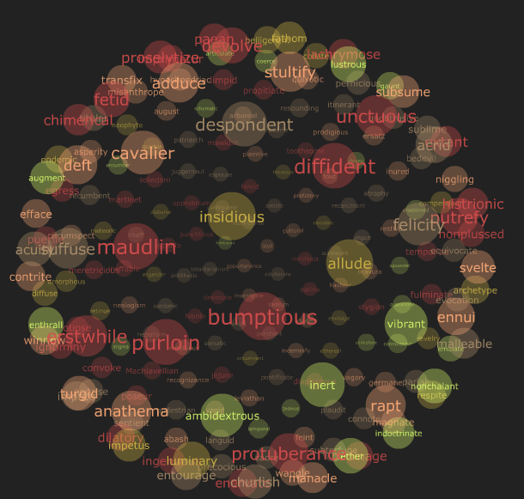
Membean is an online solution for customized vocabulary learning for every user. It offers a guided, engaging and multimodal vocabulary instruction along with an adaptive reinforcement engine that helps users retain what they learn. They cater primarily to schools in the US.
Membeam’s key objective is process automation for faster and more efficient leads, opportunity and account management to increase productivity with maximum efficiency.
As a result:
Existing CRM was replaced with Salesforce.
Streamlined the Sales Team process and automated validations & workflows for higher process efficiency.
Enabled the Quote functionality to increase turn around time for deal closure.
Dashboards and reports for key business and actionable metrics.
Membean’s sales team can now track and follow-up more effectively with added focus on the piloting or discontinued schools.
Client Endorsement
Company/Project
Ganesh Krishnan - Vice President
Sales & Marketing
“We are really excited to move over to Salesforce, and I think you'll have built a strong platform for us start building on. I really appreciate the hard work and dedication that everyone has put into this project. “

Slide 18

United Breweries Ltd., (UB) a market leader in India’s beer industry, has a market share of 50%. About 80,000 outlets cater to the entire demand, which is growing at 10% p.a.
UB salesmen needed to edge out competition at Point-of-Sale. A mobile app, PRIDE, developed on Force.com mirrors the workflow, enables a Perfect Sales Call and delivers rich SKU data in real-time to empower sales conversations with outlets.
As a result:
Sales of specialty brands are up by 48%.
Volume per outlet is up by 35%.
Escalation time lags highlighting issues have reduced from 15 days to 48 hours, giving salesmen more credibility.
The human element of PRIDE instills confidence in 700 people using Salesforce, eliminating past struggles with paperwork and mismatched records.
Company/Project
Perry Goes, Senior Vice President
Strategic Planning, Business Development, Sales Analytics & Consumer Insights
“We had a choice of going to the biggest implementation partners of Salesforce and looked at few partners. We wanted the most agile and flexible partner. ET Marlabs came across as a lean, mean, hungry machine. Quickest off the block, they brought sharp-thinking to the table and put forth new options we hadn’t considered. Also, they were willing to learn and grow with us.
One thing that’s really commendable is their ability to say, we don’t know how to do this, but how do we quickly find a solution and move along, rather than saying, it can’t be done. I think in this kind of deployment, that’s more important than anything else.
The journey of client - from where they think they want to start and end, changes often during implementation. So a partner who is flexible to adapt as you progress is important.”
Client Endorsement

Slide 19


Company/Project
Urban Ladder is among India’s fastest growing furniture e-tailers. Unlike competitors which operate as marketplaces, the Bangalore-based start-up is a curated online furniture seller owning processes end-to-end, which means they control everything.
With the faced paced growth of Urban Ladder, they needed system which could ensure high customer satisfaction. Using Salesforce Service Cloud, Urban Ladder was able to have an integrated view of the customer and their interactions with the Urban Ladder team.
As a result:
Customer service agents could respond to 50% more customer queries.
Process of ticket assignment was streamlined.
Cancellation process life cycle was reduced to 2 days.
With Salesforce, Urban Ladder was able to understand their customers better and reduce their pain points.
Nandini Vishwanath, Director
Customer Service
“ET Marlabs has been fantastic right from the beginning of requirement gathering. We came with a set of generic set of requirements and ET helped us hone those requirements further and build it out in phases. ET Marlabs brought in its vast experience of working with other clients and business which really helped us broaden our vision. We had great fun working with ET Marlabs.”
Mukund Raman, Senior Product Manager
Customer Service
“From the day we started our implementation we were clear on what we wanted and the timeframe in which we wanted it. What was great was that the team was also on the same page as us in delivering within the aggressive timelines. What stood was the commitment, expertise and agility ET Marlabs brought. The outcome was fantastic that we decided to continue our engagement with them.”
Client Endorsement

Slide 20


Krishna Chaitanya, Manager, Product
“ET Marlabs definitely brings a lot to the table, the three main things I want to endorse is the Professionalism, Quality of Resource…immense Expertise and Focus they have in Salesforce.
Our engagement with ET has been continuing for more than an year and we were impressed by the knowledge they carry and the professionalism demonstrated throughout the period.
They ensure that they deliver what they commit within the timeline they promise. They ensured that the basics they built was strong. They were are always ready to help even when given a stringent timeline… they always deliver and in the best way possible.
There are many scenarios where ET Marlabs has gone out of their way to ensure that they deliver what we really require.”
Flipkart is a leading e-commerce company and among the fast growing in the Indian marketplace. It sells almost anything from electronics, household items, clothing to books & stationery.
Flipkart had an ambitious goal to more than double their merchant numbers to 100,000 sellers by the end of the first year of their Salesforce implementation. The Salesforce implementation gave them the leverage to achieve this target.
As a result:
On boarded 100,000 sellers and 600,000 sellers in pipeline.
Bucketing sellers, they were able to capture and track the planned and unplanned activities.
Effective and efficient system to recruit, train, monitor and manage the freelancers and interim consultants.
Track, understand, monitor and support the sellers to improve the performance.
Internal employee collaboration through chatter giving more credibility to freelancers and interim consultants.
Client Endorsement
Company/Project

Slide 21


CEAT is one of India’s leading tyre manufacturers with a presence in global markets. It has a manufacturing capacity of over 95,000+ tyres per day.
CEAT needed an effective CRM for their Sales, Service and Marketing needs. Salesforce Service Cloud integrated with SAP was implemented for giving field agents insight into Sales actuals, inventory stock, pricing etc. and for the management to track the Sales cycle.
As a result:
Time take to complete monthly Sales planning came down from 2 hours to 15 mins.
Live Dashboards provide results in a matter of seconds as compared to 7 mins.
70% increase in efficiency due to PJP and CIBA app.
Order processing with all limit checks increased efficiency by 30%.
E-fleet module implementation resulted in higher Sales numbers for new or existing products.
Company/Project
Client Endorsement
Arnab Banerjee - Executive Director
Operations
“We evaluated various vendors from the very big to mid-sized ones and also ET Marlabs. ET Marlabs was one of the principal partners of Salesforce. What critically swung the deal in their favor was that we felt they were quite flexible and were willing to work as a team; their understanding of CEAT was perhaps the best within a short span of time. That made the decision making easier….they did not look at it from a SLA kind of relationship. Sometimes I had to side on behalf of ET Marlabs to ensure that we wouldn’t stretch it too far. The overall handholding and teamwork from ET was fantastic.”
Niranjan Bhalivade – Chief Information Officer
“The entire project team from ET had been very aggressive in taking the requirements. They have managed the project in a beautiful way by adding technology innovations on top of our business requirements. They were not only asking precise questions, but also co-innovating with us.”

Slide 22
people & culture

Slide 23
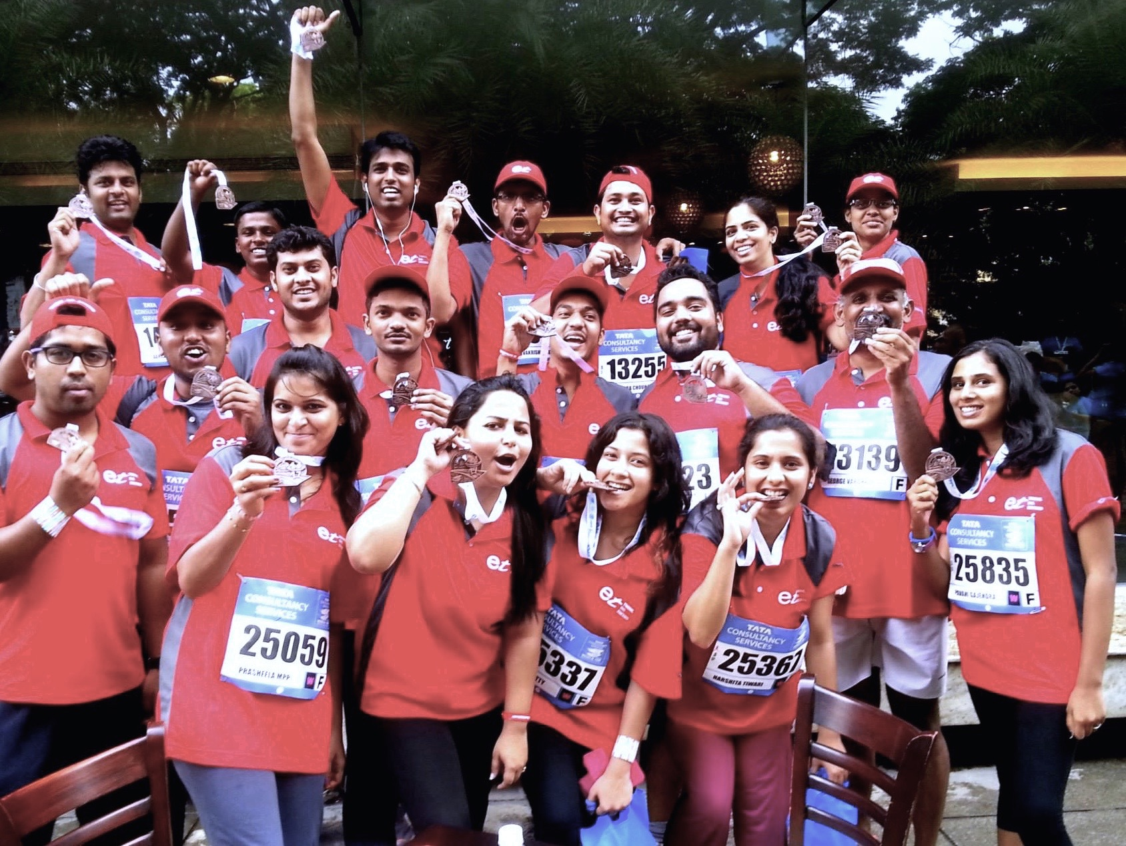


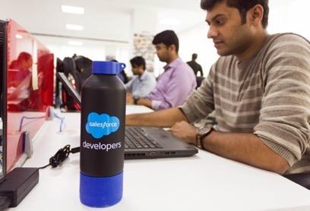
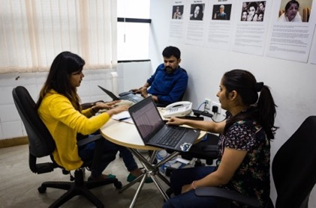

Be Extraordinary.
The value of ET Marlabs is measured by an individual’s talent and distinctiveness.
Our culture, which is a reflection of all that, embraces and celebrates uniqueness of every kind.
Our people can be their extraordinary self in our work environment, which is all about learning, working, having fun and growing as Salesforce experts to reach our full potential.
ET Marlabs’ CSR initiative called “Part of the brief” focuses on giving back to the community and aligns with 1:1:1, a Salesforce CSR program.
The In-House Training Program is called
Code the Cloud.
It ensures continuous Training & Certifications for our people.
The innovative people practices at ET Marlabs have kept attrition at less than 5%.

Slide 24
Contact Us
www.etmarlabs.com
United States
One Corporate Place South
Floor 3
Piscataway NJ 08854 – 6116
Phone: +1 (732) 694 1000
Email: Contact@marlabs.com
India
1st Floor, S R Complex
No.2, Tavarekere Main Road
S G Palya, D R C Post
Bengaluru - 560029
Tel: +91-99868-30738
Bandra Kurla Complex (BKC)
Level 7, The Capital, B- wing
Plot C – 70, G Block
Bandra (E), Mumbai- 400051
Tel: +91-98209-79713
Email: enquiries@etmarlabs.com

Slide 25
Empowering business and delighting customers with Salesforce
September 2016

Slide 26
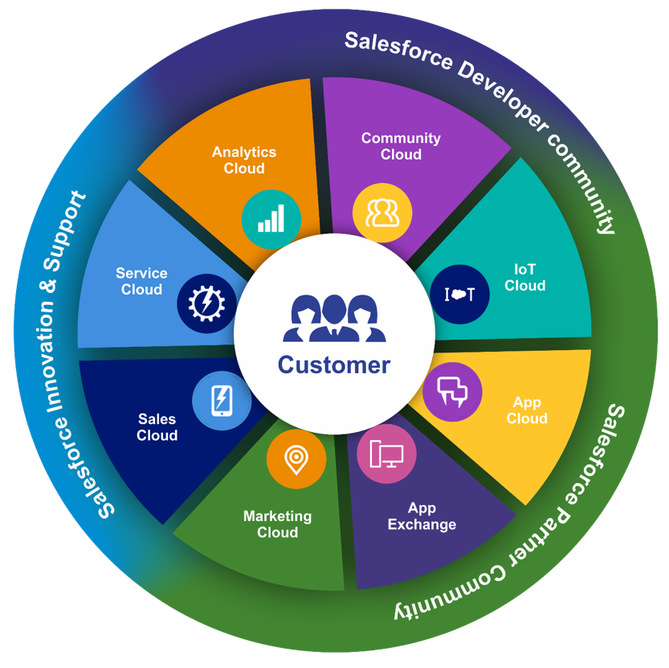
Salesforce Eco-system

Slide 27
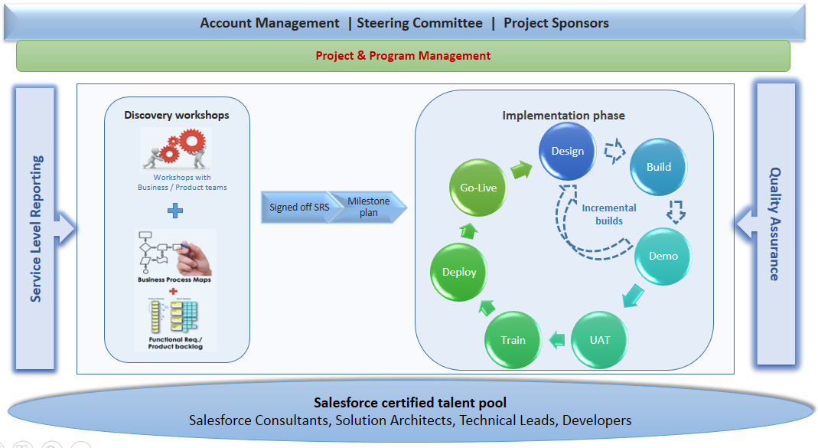
ET Marlabs Delivery Model

